Slide 1
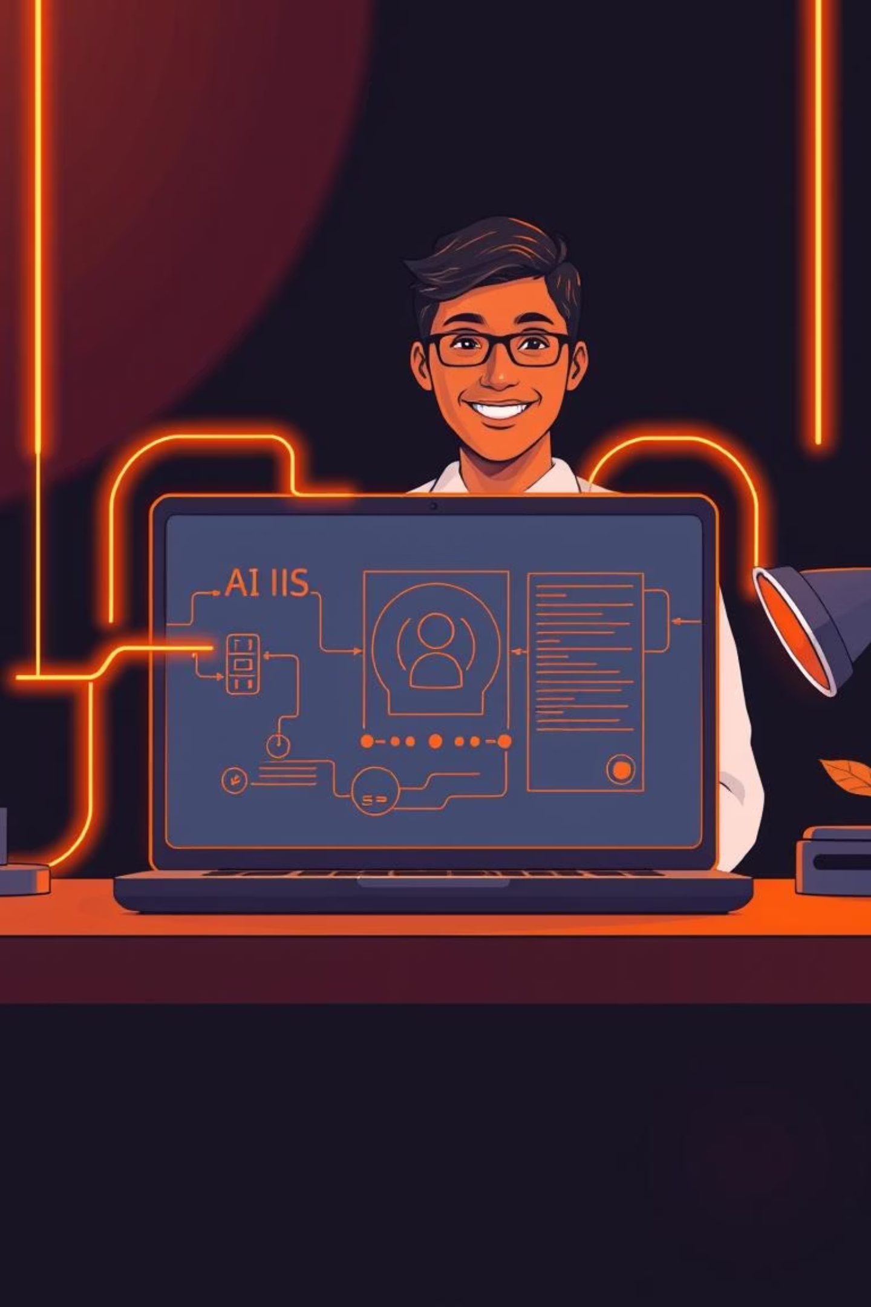
AI-Powered Mock Interview Platform
Using Modern Web Technologies to Revolutionize Interview Prep
Mukul Dhiman
Minakshi Tomar
Muskan Chaudhary

Slide 2
Introduction: Why AI Mock Interviews?
Realistic Simulation
Instant, Personalized Feedback
Confidence Building
Our platform simulates diverse interview scenarios: technical, behavioral, and case studies, mirroring real-world pressures.
Receive immediate, AI-driven insights to refine your answers, improve delivery, and eliminate common speaking habits like filler words and hesitation.
Through repeated, stress-free practice sessions, our application builds your confidence, transforming nervousness into preparedness.

Slide 3




Core Features & User Benefits
Adaptive Questioning
Real-Time AI Coaching
Flexible Practice Modes
24/7 Accessibility
Tailored interview questions based on specific job roles and industry demands.
Actionable insights and improved sample answers provided on the fly.
No scheduling constraints; practice on your own terms, whenever you need.
Practice with audio recording, text input, and live transcription options.

Slide 4


Technologies Powering Our Application
React
HTML & CSS
Dynamic, responsive user interface for seamless experience.
Clean, accessible design with intuitive layouts and styling.
JavaScript
Node.js
Interactive features and real-time AI integration.
Robust backend handling AI requests and user sessions.

Slide 5
Key Modules of the Project
01
02
User Authentication
Interview Creation
Secure login and signup mechanisms using Firebase or Clerk Auth, ensuring user data privacy and seamless access.
Allows users to customize interview sessions based on job role, industry, and difficulty level for targeted practice.
03
04
AI-Driven Interview Engine
Comprehensive Feedback System
Provides real-time AI question prompts, analyzes spoken or typed answers, and adapts the interview flow dynamically.
Delivers instant, actionable insights through text-to-speech summaries and detailed AI-generated performance reports, highlighting strengths and areas for improvement.

Slide 6
Conclusion & Future Directions
Our AI-powered mock interview platform redefines interview preparation, offering personalized, data-driven insights through intelligent technology.
Key Achievements
Future Innovations
AI mock interviews transform preparation with personalized, data-driven insights.
Resume-based interview tailoring for highly specific practice scenarios.
Scalable architecture using React & Node.js ensures extensibility and future growth.
Multi-language support to cater to a global user base.
Advanced analytics and progress tracking for deeper self-assessment.
Join us in shaping the future of interview readiness with AI-powered innovation!

Slide 7

Join the Future of Interview Prep Today!
Empower your career with AI-driven mock interviews. Practice smarter, improve faster, and land your dream job with confidence.
Ready to ace your next interview? Let’s get started!

